Slide 1
Rebecca Czyrnik
Galvanize Data Science Resident

Slide 2
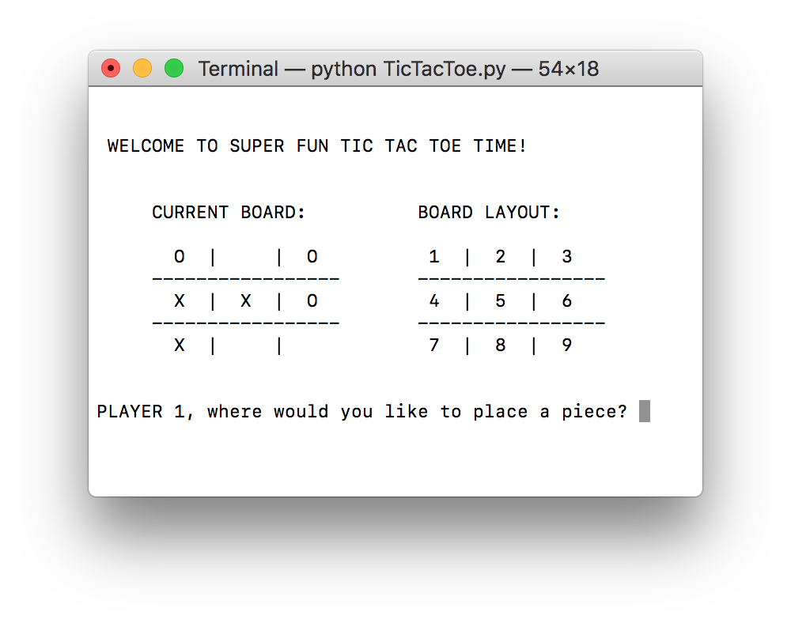
What is it?
?

Slide 3
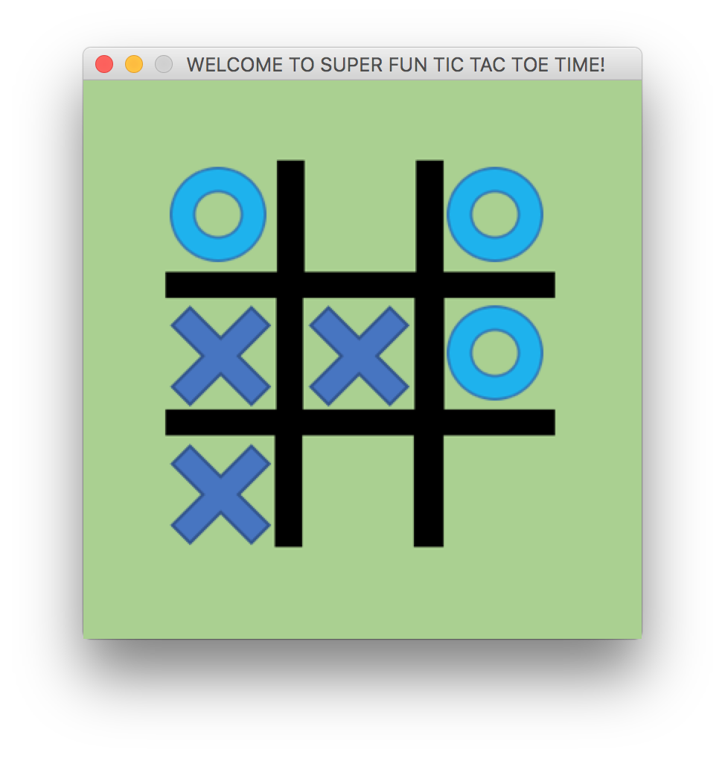
What is it?

Slide 4
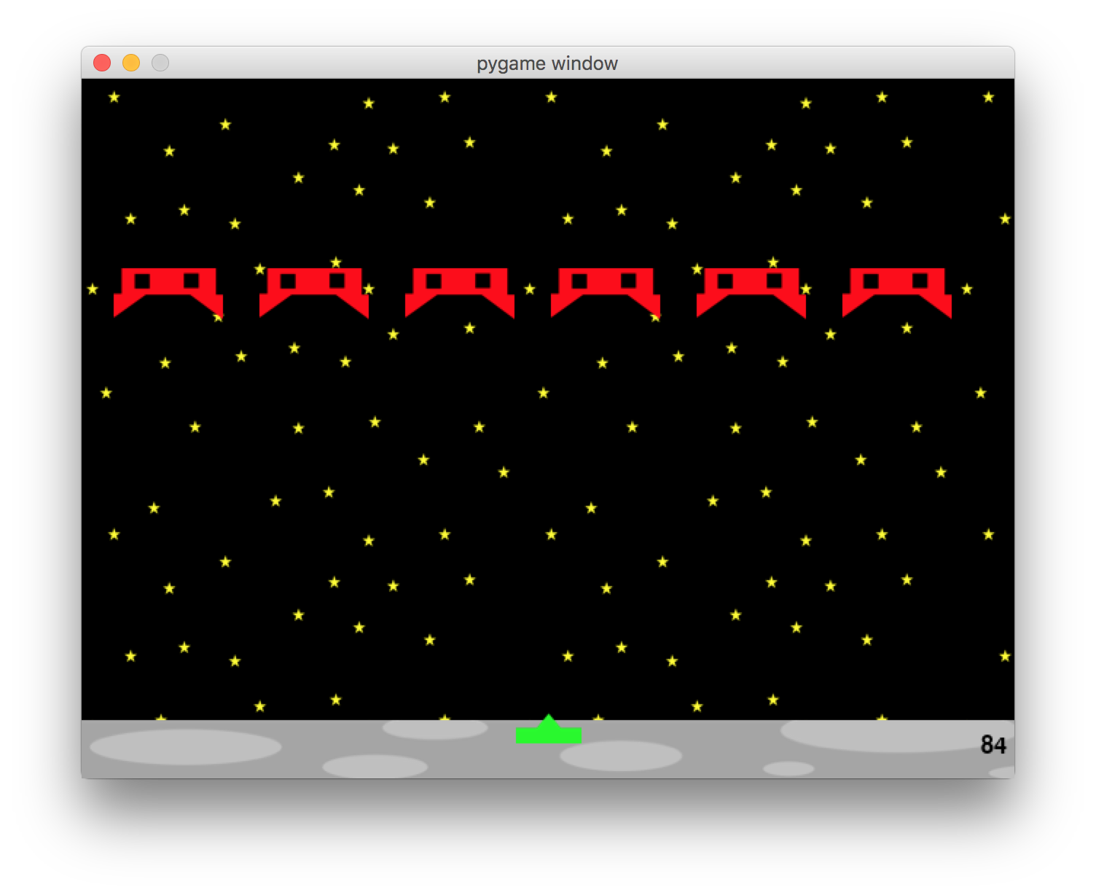
Why?

Slide 5
But really, why?
Adds color and shape to your program*
Allows you to do more things
Stepping stone to more advanced Python.

Slide 6

Some Examples of Object Oriented Programming
my_object = TheClassName(attribute_1, attribute_2)
a_variable = my_object.some_method()
another_variable = my_object.some_attribute
my_shape=Surface((100,50))
my_shape.fill((0,0,255))
my_shape_rect = my_shape.get_rect()
my_shape_rect.topleft = (200,150)

Slide 7
Reading The Docs
https://www.pygame.org/docs/ref/surface.html
https://www.pygame.org/docs/ref/rect.html
http://pygame2.readthedocs.io/en/latest/pygame2.rect.html

Slide 8
Let's Do Stuff!
Display a rectangle
Change the color of the rectangle when we click anywhere
Change the color of the rectangle when we click on it
Make the rectangle move back and forth
Replace the rectangle with an image

Slide 9
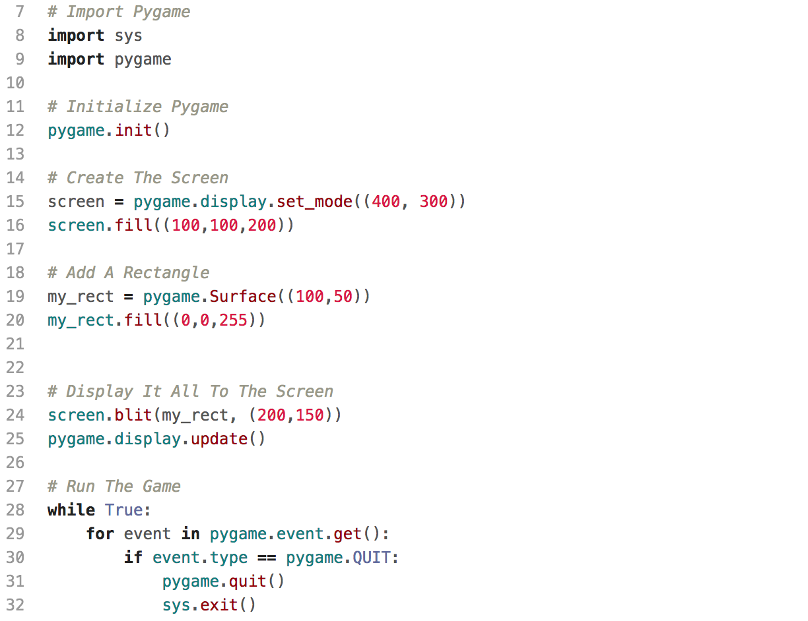
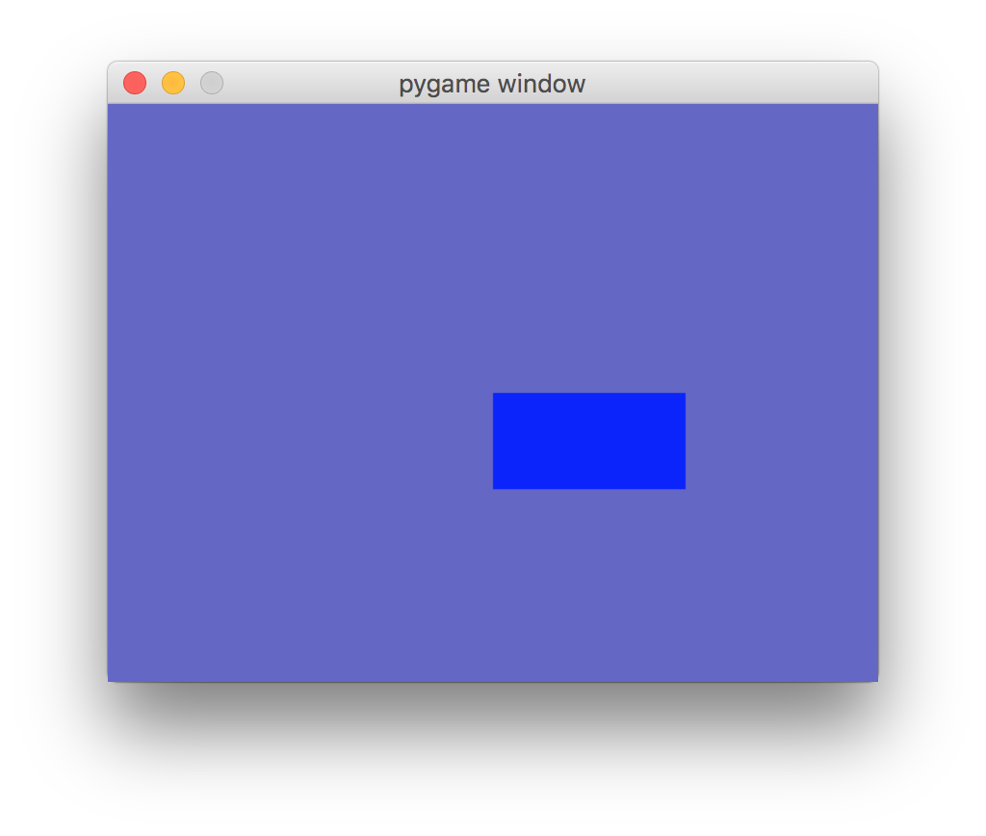
How does it work? (pygame_tutorial_0.py)
Setup
Run
Notes:
sys so can exit the game
explain what all the numbers are
experiment with removing the run the game part (hint: doesn't work well)

Slide 10
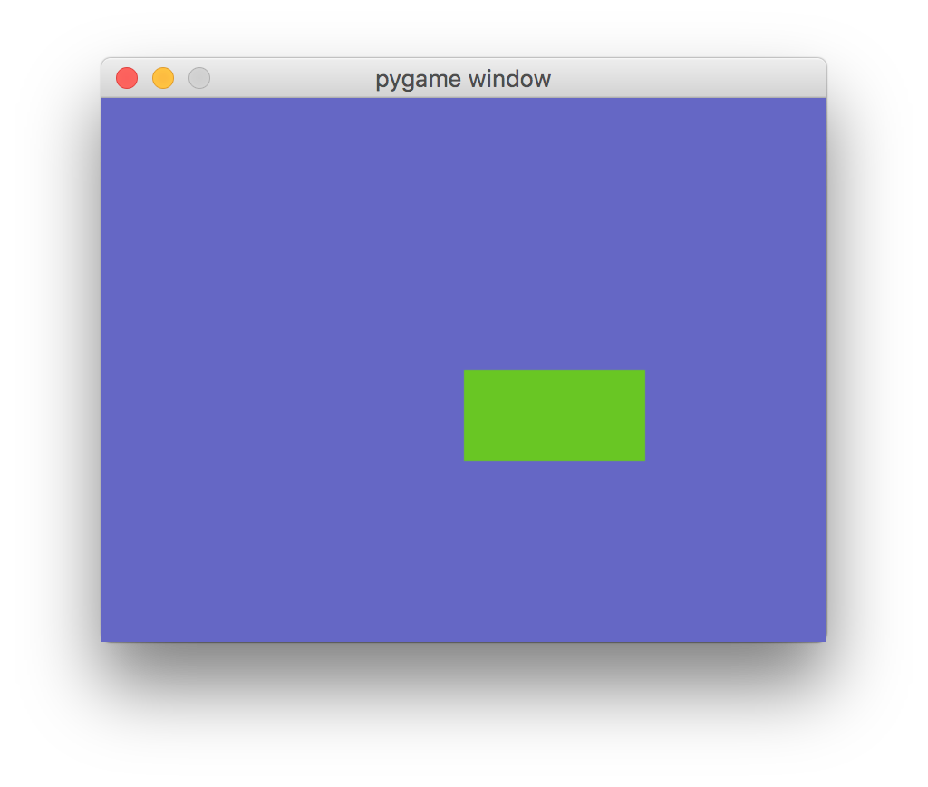
Interesting Change 1:
CHANGE THE COLOR WHEN WE CLICK
In the event loop:
elif event.type == pygame.MOUSEBUTTONDOWN:
red = random.randint(0, 255)
blue = random.randint(0, 255)
green = random.randint(0, 255)
my_rect.fill((red, blue, green))
screen.blit(my_rect, (200,150))
pygame.display.update()
Notes:
sys so can exit the game
explain what all the numbers are
experiment with removing the run the game part (hint: doesn't work well)

Slide 11

Interesting Change 2:
CHANGE THE COLOR WHEN WE CLICK
ON THE BOX
In the # Add A Rectangle
my_shape_rect = my_shape.get_rect()
my_shape_rect.topleft = (200,150)
Wherever we screen.blit(my_rect, (200,150))
screen.blit(my_rect, my_shape_rect)
Inside the elif event.type == pygame.MOUSEBUTTONDOWN loop
mouse_position = pygame.mouse.get_pos()
if my_shape_rect.collidepoint(mouse_position):
(do color change stuff)
Notes:
sys so can exit the game
explain what all the numbers are
experiment with removing the run the game part (hint: doesn't work well)

Slide 12
Interesting Change 3:
MOVE THE BOX
In the game loop, outside the event loop:
# Move Rectangles's Position
amt_to_move = 2
my_shape_rect = my_shape_rect.move((amt_to_move, 0))
How did that work?
Notes:
sys so can exit the game
explain what all the numbers are
experiment with removing the run the game part (hint: doesn't work well)

Slide 13

Interesting Change 4:
ADDING IMAGES
Find a fun image online. It's better if it doesn't have a background
Replace Rectangle code with Image code
Rectangle code:
rect_color = (0,0,255)
my_shape = pygame.Surface((100,50))
my_shape.fill(rect_color)
Image code:
my_shape = pygame.image.load('img/white_dog.png')
my_shape = pygame.transform.scale(my_shape, (80,80))
Remove the rectangle color changing code. Replace it with code that changes the background color.
Notes:
https://ae01.alicdn.com/kf/HTB1gUAxdUF7MKJjSZFLq6AMBVXag/13-10-4CM-Baby-Pet-Cute-Dog-Cartoon-Window-Decals-Funny-Animal-Car-Sticker-Accessories.jpg_640x640.jpg

Slide 14
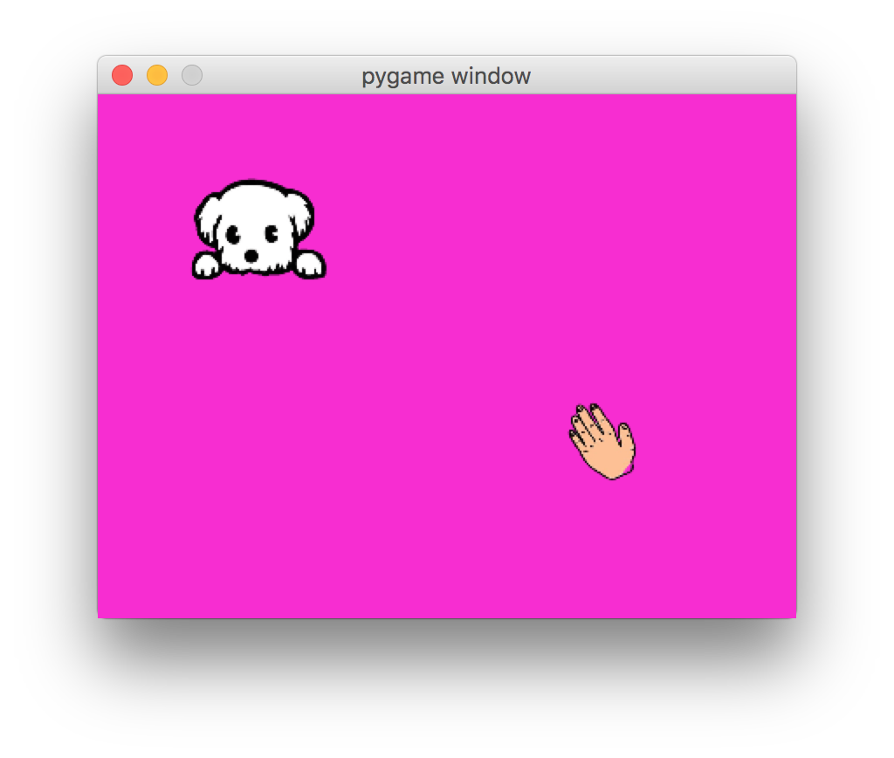
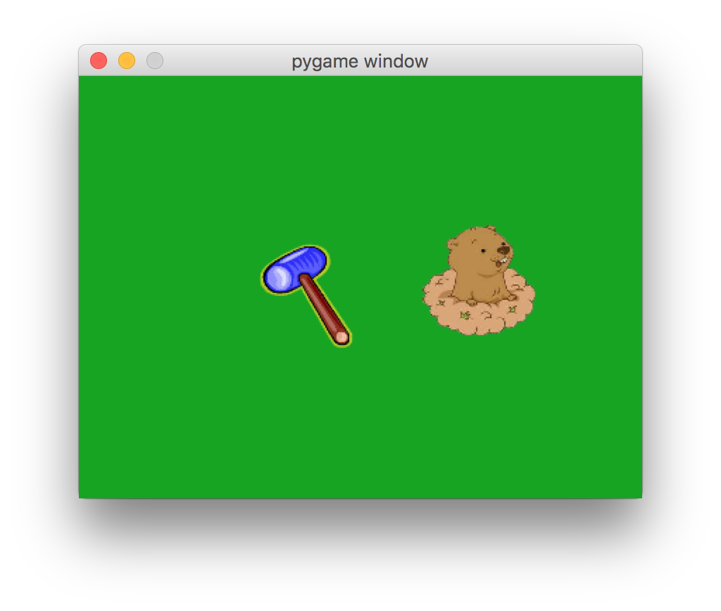
More Ideas
Move the image in two dimensions
Change the cursor images
Make the image move faster when you click on it.
Make it move more erratically
Change the theme
Have more images appear
Have the images disappear after a time
Add a score board
Notes:
https://d2v9y0dukr6mq2.cloudfront.net/video/thumbnail/uh59Wh0/palm-hand-icon-cartoon-illustration-hand-drawn-animation-transparent_41gyct___S0004.jpg

Slide 15
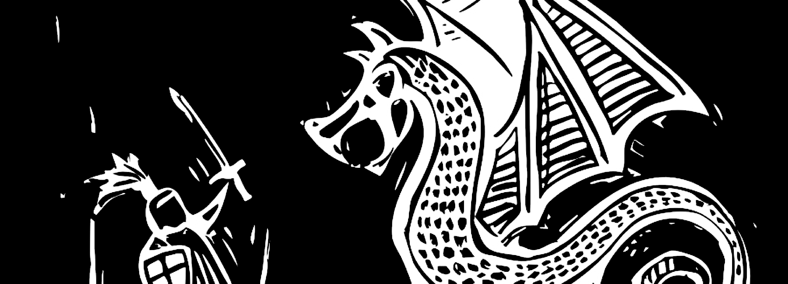
A Final Note
Notes:
https://www.morganmckinley.co.uk/sites/galileo.morganmckinley.co.uk/files/styles/blog_banner/public/dragon.jpg?itok=G4ajnNBT

Slide 16
Good intro Links
http://www.cs.ucsb.edu/~pconrad/cs5nm/topics/pygame/drawing/
Walks through the absolute basics

Slide 17
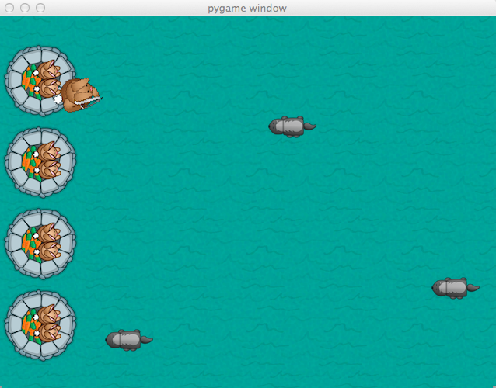
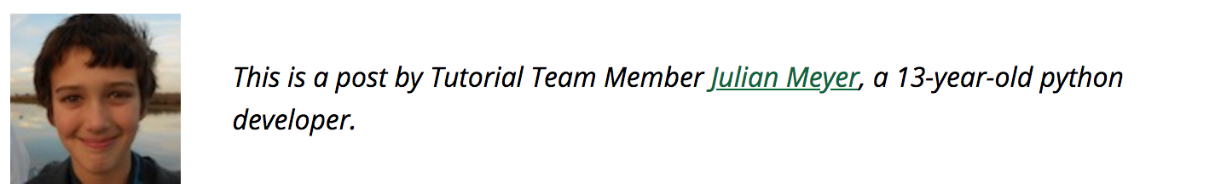
Really Good Tutorial: Hello Bunny
Check comments for updated code
(thank you masterf​00)
Super eloquent and engaging
Almost easy to follow
By a 13 year old!
https://www.raywenderlich.com/24252/beginning-game-programming-for-teens-with-python

